Slide 1
SOAR Program Requirements
The RMI/GIS Professional Development Program Series

Slide 2
Workshop Requirements Attend 3 workshops offered during the semester. Workshops may include prerecorded webinars as qualifying events.

Slide 3
Personal LinkedIn Profile Requirements
You must complete each of the below requirements:
Establish and successfully maintain a personal LinkedIn account.
2. Upload a professional headshot to your LinkedIn account.
3. Successfully connect with the below on LinkedIn:
Sally Carne, RMI Prog Coordinator

Slide 4
Personal Resume Requirement
You must complete each of the below requirements:
1. Create a personal resume.
2. Submit your resume to the Career Center to request that they assign a grade to your resume (1 through 5).
3. MUST obtain a grade of "5" through the Career Center on your resume.
*If your grade is not a "5", work with the Career Center to improve your resume until you receive a "5"!

Slide 5
SOAR Program Microsoft Team Details
We will use Microsoft Teams as our main form of communication regarding the Professional Development Program!
You will be added to the SOAR Program Team immediately after you sign up for the program.
Announcements, reminders, and requirements tracking will all be accessed through the Microsoft Team.

Slide 6
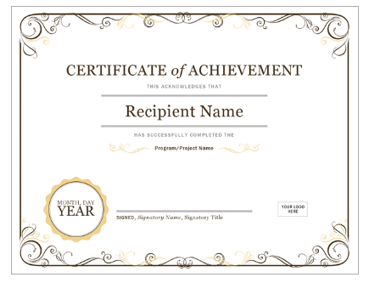
Upon successful completion of the program, students will be presented with:
1. SOAR Program Certificate of Achievement to upload to the "Featured" section of your personal LinkedIn page
2. You will also receive a graduation cord to represent the completion of the UNT RMI/GIS SOAR Professional Development Program!

Slide 7
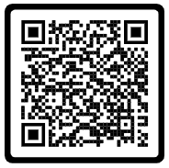
Sign up for the program with the link or QR code below!
https://www.untgis.com/event-details/soar-professional-development-program-fall-2021-registration

